Slide 1
Introduction to Data Science
John P Dickerson
Lecture #4 – 09/10/2020
CMSC320
Tuesdays & Thursdays
5:00pm – 6:15pm (… or anytime on the Internet)

Slide 2
Announcements
Register on Piazza: piazza.com/umd/fall2020/cmsc320
249 have registered already
~1 has not registered yet
If you were on Piazza, you’d know …
Project 1 will be out shortly. (Worth 10% of grade, as are each of the four projects.)
Link will be on course website @ cmsc320.github.io
We’ve also linked some reading for the week!
Second quiz is due Tuesday at noon; on ELMS now.

Slide 3
Today’s Lecture (Continuation of Lec #3)
Data collection
Data processing
Exploratory analysis
&
Data viz
Analysis, hypothesis testing, & ML
Insight & Policy Decision
… on to the “collection” part of things …

Slide 4
GotTa Catch ‘Em All
Five ways to get data:
Direct download and load from local storage
Generate locally via downloaded code (e.g., simulation)
Query data from a database (covered in a few lectures)
Query an API from the intra/internet
Scrape data from a webpage
Covered today.

Slide 5
Wherefore art thou, API?
A web-based Application Programming Interface (API) like we’ll be using in this class is a contract between a server and a user stating:
“If you send me a specific request, I will return some information in a structured and documented format.”
(More generally, APIs can also perform actions, may not be web-based, be a set of protocols for communicating between processes, between an application and an OS, etc.)
Notes:
”Wherefore” means “why”, not “where”!

Slide 6
“Send me a specific request”
Most web API queries we’ll be doing will use HTTP requests:
conda install –c anaconda requests=2.12.4
r = requests.get( 'https://api.github.com/user', auth=('user', 'pass') )
r.status_code
200
r.headers[‘content-type’]
‘application/json; charset=utf8’
r.json()
{u'private_gists': 419, u'total_private_repos': 77, ...}
http://docs.python-requests.org/en/master/

Slide 7
HTTP Requests
https://www.google.com/?q=cmsc320&tbs=qdr:m
HTTP GET Request:
GET /?q=cmsc320&tbs=qdr:m HTTP/1.1 Host: www.google.com User-Agent: Mozilla/5.0 (X11; Linux x86_64; rv:10.0.1) Gecko/20100101 Firefox/10.0.1
??????????
params = { “q”: “cmsc320”, “tbs”: “qdr:m” }
r = requests.get( “https://www.google.com”, params = params )
*be careful with https:// calls; requests will not verify SSL by default

Slide 8
Restful APIs
This class will just query web APIs, but full web APIs typically allow more.
Representational State Transfer (RESTful) APIs:
GET: perform query, return data
POST: create a new entry or object
PUT: update an existing entry or object
DELETE: delete an existing entry or object
Can be more intricate, but verbs (“put”) align with actions

Slide 9
Querying a Restful API
Stateless: with every request, you send along a token/authentication of who you are
GitHub is more than a GETHub:
PUT/POST/DELETE can edit your repositories, etc.
Try it out: https://github.com/settings/tokens/new
token = ”super_secret_token”
r = requests.get(“https://github.com/user”,
params={”access_token”: token})
print( r.content )
{"login":”JohnDickerson","id":472985,"avatar_url":"ht…

Slide 10
Authentication and OAuth
Old and busted:
New hotness:
What if I wanted to grant an app access to, e.g., my Facebook account without giving that app my password?
OAuth: grants access tokens that give (possibly incomplete) access to a user or app without exposing a password
r = requests.get(“https://api.github.com/user”,
auth=(“JohnDickerson”, “ILoveKittens”))

Slide 11
“… I will return information in a structured format.”
So we’ve queried a server using a well-formed GET request via the requests Python module. What comes back?
General structured data:
Comma-Separated Value (CSV) files & strings
Javascript Object Notation (JSON) files & strings
HTML, XHTML, XML files & strings
Domain-specific structured data:
Shapefiles: geospatial vector data (OpenStreetMap)
RVT files: architectural planning (Autodesk Revit)
You can make up your own! Always document it.

Slide 12
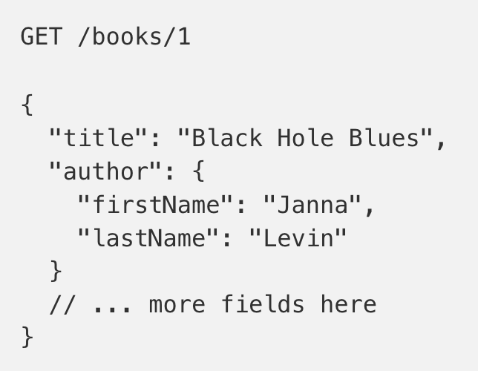
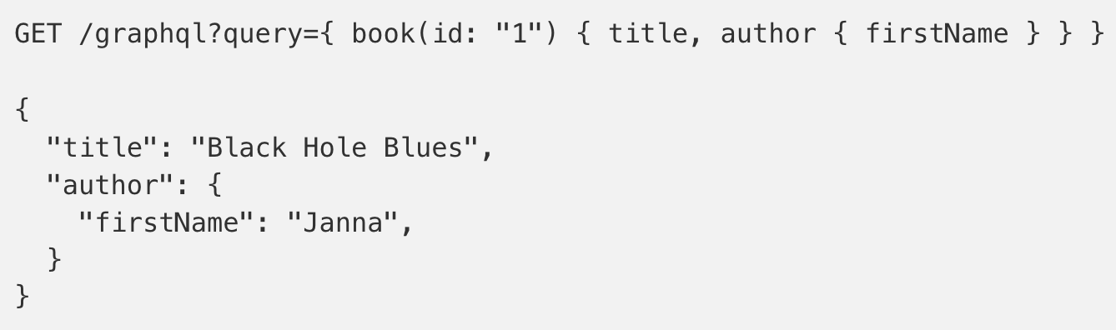
GraphQL?
An alternative to REST and ad-hoc webservice architectures
Developed internally by Facebook and released publicly
Unlike REST, the requester specifies the format of the response
https://dev-blog.apollodata.com/graphql-vs-rest-5d425123e34b

Slide 13
CSV Files in Python
Any CSV reader worth anything can parse files with any delimiter, not just a comma (e.g., “TSV” for tab-separated)
1,26-Jan,Introduction,—,"pdf, pptx",Dickerson, 2,31-Jan,Scraping Data with Python,Anaconda's Test Drive.,,Dickerson, 3,2-Feb,"Vectors, Matrices, and Dataframes",Introduction to pandas.,,Dickerson, 4,7-Feb,Jupyter notebook lab,,,"Denis, Anant, & Neil", 5,9-Feb,Best Practices for Data Science Projects,,,Dickerson,
Don’t write your own CSV or JSON parser
(We’ll use pandas to do this much more easily and efficiently)
import csv
with open(“schedule.csv”, ”rb”) as f:
reader = csv.reader(f, delimiter=“,”, quotechar=’”’)
for row in reader:
print(row)

Slide 14
JSON Files & Strings
JSON is a method for serializing objects:
Convert an object into a string (done in Java in 131/132?)
Deserialization converts a string back to an object
Easy for humans to read (and sanity check, edit)
Defined by three universal data structures
Python dictionary, Java Map, hash table, etc …
Python list, Java array, vector, etc …
Python string, float, int, boolean, JSON object, JSON array, …
Images from: http://www.json.org/

Slide 15
JSON In Python
Some built-in types: “Strings”, 1.0, True, False, None
Lists: [“Goodbye”, “Cruel”, “World”]
Dictionaries: {“hello”: “bonjour”, “goodbye”, “au revoir”}
Dictionaries within lists within dictionaries within lists:
[1, 2, {“Help”:[ “I’m”, {“trapped”: “in”}, “CMSC320” ]}]

Slide 16
JSON From Twitter
GET https://api.twitter.com/1.1/friends/list.json?cursor=-1&screen_name=twitterapi&skip_status=true&include_user_entities=false
{ "previous_cursor": 0,
"previous_cursor_str": "0",
"next_cursor": 1333504313713126852,
"users": [{
"profile_sidebar_fill_color": "252429",
"profile_sidebar_border_color": "181A1E",
"profile_background_tile": false,
"name": "Sylvain Carle",
"profile_image_url": "http://a0.twimg.com/profile_images/2838630046/4b82e286a659fae310012520f4f756bb_normal.png",
"created_at": "Thu Jan 18 00:10:45 +0000 2007", …

Slide 17
Parsing JSON In Python
Repeat: don’t write your own CSV or JSON parser
https://news.ycombinator.com/item?id=7796268
rsdy.github.io/posts/dont_write_your_json_parser_plz.html
Python comes with a fine JSON parser
import json
r = requests.get( “https://api.twitter.com/1.1/statuses/user_timeline.json?screen_name=JohnPDickerson&count=100”, auth=auth )
data = json.loads(r.content)
json.load(some_file) # loads JSON from a file
json.dump(json_obj, some_file) # writes JSON to file
json.dumps(json_obj) # returns JSON string

Slide 18
XML, XHTML, HTML files and Strings
Still hugely popular online, but JSON has essentially replaced XML for:
Asynchronous browser ←→ server calls
Many (most?) newer web APIs
XML is a hierarchical markup language:
<tag attribute=“value1”> <subtag> Some content goes here </subtag> <openclosetag attribute=“value2” /> </tag>
You probably won’t see much XML, but you will see plenty of HTML, its substantially less well-behaved cousin …
Example XML from: Zico Kolter

Slide 19
Document Object Model (DOM)
XML encodes Document-Object Models (“the DOM”)
The DOM is tree-structured.
Easy to work with! Everything is encoded via links.
Can be huge, & mostly full of stuff you don’t need …

Slide 20
SAX
SAX (Simple API for XML) is an alternative “lightweight” way to process XML.
A SAX parser generates a stream of events as it parses the XML file. The programmer registers handlers for each one.
It allows a programmer to handle only parts of the data structure.
Example from John Canny

Slide 21
Scraping HTML in Python
HTML – the specification – is fairly pure
HTML – what you find on the web – is horrifying
We’ll use BeautifulSoup:
conda install -c asmeurer beautiful-soup=4.3.2
import requests
from bs4 import BeautifulSoup
r = requests.get( “https://cmsc320.github.io” )
root = BeautifulSoup( r.content )
root.find(“div”, id=“schedule”)\
.find(“table”)\ # find all schedule
.find(“tbody”).findAll(“a”) # links for CMSC320

Slide 22
Building a web scraper in python
Totally not hypothetical situation:
You really want to learn about data science, so you choose to download all of last semester’s CMSC320 lecture slides to wallpaper your room …
… but you now have carpal tunnel syndrome from clicking refresh on Piazza last night, and can no longer click on the PDF and PPTX links.
Hopeless? No! Earlier, you built a scraper to do this!
Sort of. You only want PDF and PPTX files, not links to other websites or files.
lnks = root.find(“div”, id=“schedule”)\
.find(“table”)\ # find all schedule
.find(“tbody”).findAll(“a”) # links for CMSC320

Slide 23
Regular Expressions
Given a list of URLs (strings), how do I find only those strings that end in *.pdf or *.pptx?
Regular expressions!
(Actually Python strings come with a built-in endswith function.)
What about .pDf or .pPTx, still legal extensions for PDF/PPTX?
Regular expressions!
(Or cheat the system again: built-in string lower function.)
“this_is_a_filename.pdf”.endswith((“.pdf”, “.pptx”))
“tHiS_IS_a_FileNAme.pDF”.lower().endswith( (“.pdf”, “.pptx”))

Slide 24
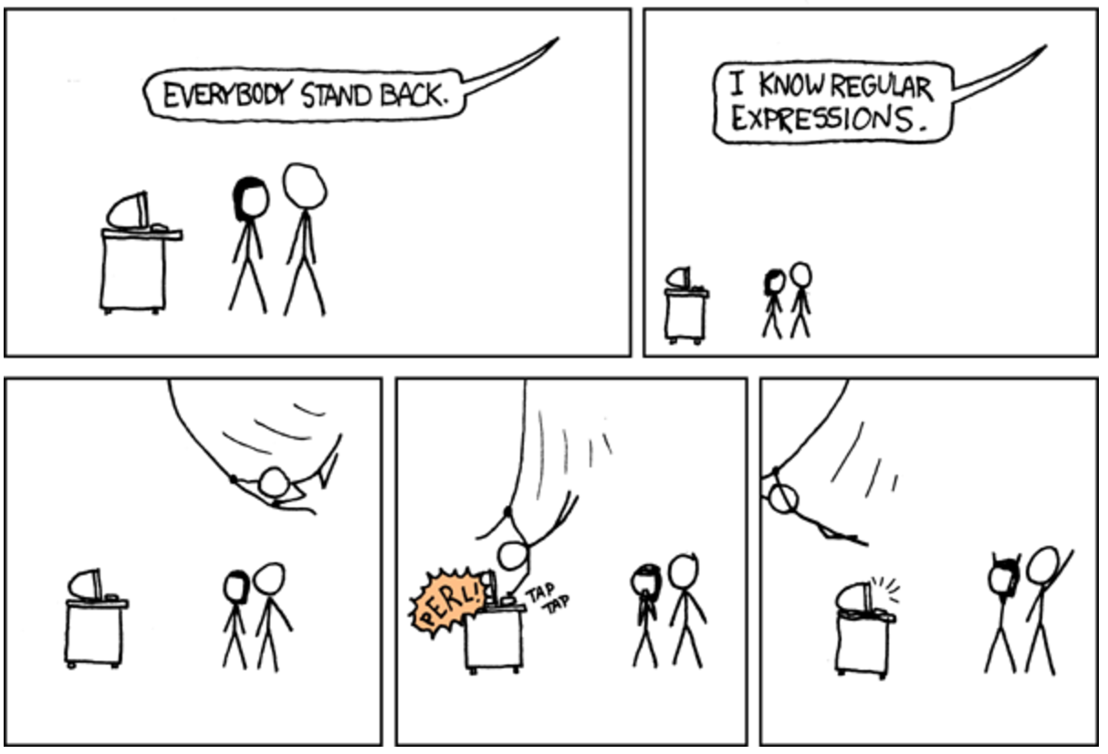

Slide 25
Regular Expressions
Used to search for specific elements, or groups of elements, that match a pattern
Indispensable for data munging and wrangling
Many constructs to search a variety of different patterns
Many languages/libraries (including Python) allow “compiling”
Much faster for repeated applications of the regex pattern
https://blog.codinghorror.com/to-compile-or-not-to-compile/

Slide 26
Regular Expressions
Used to search for specific elements, or groups of elements, that match a pattern
import re
# Find the index of the 1st occurrence of “cmsc320”
match = re.search(r”cmsc320”, text)
print( match.start() )
# Does start of text match “cmsc320”?
match = re.match(r”cmsc320”, text)
# Iterate over all matches for “cmsc320” in text
for match in re.finditer(r”cmsc320”, text):
print( match.start() )
# Return all matches of “cmsc320” in the text
match = re.findall(r”cmsc320”, text)

Slide 27
Matching Multiple Characters
Can match sets of characters, or multiple and more elaborate sets and sequences of characters:
Match the character ‘a’: a
Match the character ‘a’, ‘b’, or ‘c’: [abc]
Match any character except ‘a’, ‘b’, or ‘c’: [^abc]
Match any digit: \d (= [0123456789] or [0-9])
Match any alphanumeric: \w (= [a-zA-Z0-9_])
Match any whitespace: \s (= [ \t\n\r\f\v])
Match any character: .
Special characters must be escaped: .^$*+?{}\[]|()
Thanks to: Zico Kolter

Slide 28
Matching sequences and repeated characters
A few common modifiers (available in Python and most other high-level languages; +, {n}, {n,} may not):
Match character ‘a’ exactly once: a
Match character ‘a’ zero or once: a?
Match character ‘a’ zero or more times: a*
Match character ‘a’ one or more times: a+
Match character ‘a’ exactly n times: a{n}
Match character ‘a’ at least n times: a{n,}
Example: match all instances of “University of <somewhere>” where <somewhere> is an alphanumeric string with at least 3 characters:
\s*University\sof\s\w{3,}

Slide 29
Groups
What if we want to know more than just “did we find a match” or “where is the first match” …?
Grouping asks the regex matcher to keep track of certain portions – surrounded by (parentheses) – of the match
\s*([Uu]niversity)\s([Oo]f)\s(\w{3,})
regex = r”\s*([Uu]niversity)\s([Oo]f)\s(\w{3,})”
m = re.search( regex, “university Of Maryland” )
print( m.groups() )
('university', 'Of', 'Maryland')

Slide 30
Simple Example: Parse an Email Address
(?:(?:\r\n)?[ \t])*(?:(?:(?:[^()<>@,;:\\".\[\] \000-\031]+(?:(?:(?:\r\n)?[ \t] )+|\Z|(?=[\["()<>@,;:\\".\[\]]))|"(?:[^\"\r\\]|\\.|(?:(?:\r\n)?[ \t]))*"(?:(?: \r\n)?[ \t])*)(?:\.(?:(?:\r\n)?[ \t])*(?:[^()<>@,;:\\".\[\] \000-\031]+(?:(?:( ?:\r\n)?[ \t])+|\Z|(?=[\["()<>@,;:\\".\[\]]))|"(?:[^\"\r\\]|\\.|(?:(?:\r\n)?[ \t]))*"(?:(?:\r\n)?[ \t])*))*@(?:(?:\r\n)?[ \t])*(?:[^()<>@,;:\\".\[\] \000-\0 31]+(?:(?:(?:\r\n)?[ \t])+|\Z|(?=[\["()<>@,;:\\".\[\]]))|\[([^\[\]\r\\]|\\.)*\ ](?:(?:\r\n)?[ \t])*)(?:\.(?:(?:\r\n)?[ \t])*(?:[^()<>@,;:\\".\[\] \000-\031]+ (?:(?:(?:\r\n)?[ \t])+|\Z|(?=[\["()<>@,;:\\".\[\]]))|\[([^\[\]\r\\]|\\.)*\](?: (?:\r\n)?[ \t])*))*|(?:[^()<>@,;:\\".\[\] \000-\031]+(?:(?:(?:\r\n)?[ \t])+|\Z |(?=[\["()<>@,;:\\".\[\]]))|"(?:[^\"\r\\]|\\.|(?:(?:\r\n)?[ \t]))*"(?:(?:\r\n) ?[ \t])*)*\<(?:(?:\r\n)?[ \t])*(?:@(?:[^()<>@,;:\\".\[\] \000-\031]+(?:(?:(?:\ r\n)?[ \t])+|\Z|(?=[\["()<>@,;:\\".\[\]]))|\[([^\[\]\r\\]|\\.)*\](?:(?:\r\n)?[ \t])*)(?:\.(?:(?:\r\n)?[ \t])*(?:[^()<>@,;:\\".\[\] \000-\031]+(?:(?:(?:\r\n) ?[ \t])+|\Z|(?=[\["()<>@,;:\\".\[\]]))|\[([^\[\]\r\\]|\\.)*\](?:(?:\r\n)?[ \t] )*))*(?:,@(?:(?:\r\n)?[ \t])*(?:[^()<>@,;:\\".\[\] \000-\031]+(?:(?:(?:\r\n)?[ \t])+|\Z|(?=[\["()<>@,;:\\".\[\]]))|\[([^\[\]\r\\]|\\.)*\](?:(?:\r\n)?[ \t])* )(?:\.(?:(?:\r\n)?[ \t])*(?:[^()<>@,;:\\".\[\] \000-\031]+(?:(?:(?:\r\n)?[ \t] )+|\Z|(?=[\["()<>@,;:\\".\[\]]))|\[([^\[\]\r\\]|\\.)*\](?:(?:\r\n)?[ \t])*))*) *:(?:(?:\r\n)?[ \t])*)?(?:[^()<>@,;:\\".\[\] \000-\031]+(?:(?:(?:\r\n)?[ \t])+ |\Z|(?=[\["()<>@,;:\\".\[\]]))|"(?:[^\"\r\\]|\\.|(?:(?:\r\n)?[ \t]))*"(?:(?:\r \n)?[ \t])*)(?:\.(?:(?:\r\n)?[ \t])*(?:[^()<>@,;:\\".\[\] \000-\031]+(?:(?:(?: \r\n)?[ \t])+|\Z|(?=[\["()<>@,;:\\".\[\]]))|"(?:[^\"\r\\]|\\.|(?:(?:\r\n)?[ \t ]))*"(?:(?:\r\n)?[ \t])*))*@(?:(?:\r\n)?[ \t])*(?:[^()<>@,;:\\".\[\] \000-\031 ]+(?:(?:(?:\r\n)?[ \t])+|\Z|(?=[\["()<>@,;:\\".\[\]]))|\[([^\[\]\r\\]|\\.)*\]( ?:(?:\r\n)?[ \t])*)(?:\.(?:(?:\r\n)?[ \t])*(?:[^()<>@,;:\\".\[\] \000-\031]+(? :(?:(?:\r\n)?[ \t])+|\Z|(?=[\["()<>@,;:\\".\[\]]))|\[([^\[\]\r\\]|\\.)*\](?:(? :\r\n)?[ \t])*))*\>(?:(?:\r\n)?[ \t])*)|(?:[^()<>@,;:\\".\[\] \000-\031]+(?:(? :(?:\r\n)?[ \t])+|\Z|(?=[\["()<>@,;:\\".\[\]]))|"(?:[^\"\r\\]|\\.|(?:(?:\r\n)? [ \t]))*"(?:(?:\r\n)?[ \t])*)*:(?:(?:\r\n)?[ \t])*(?:(?:(?:[^()<>@,;:\\".\[\] \000-\031]+(?:(?:(?:\r\n)?[ \t])+|\Z|(?=[\["()<>@,;:\\".\[\]]))|"(?:[^\"\r\\]| \\.|(?:(?:\r\n)?[ \t]))*"(?:(?:\r\n)?[ \t])*)(?:\.(?:(?:\r\n)?[ \t])*(?:[^()<> @,;:\\".\[\] \000-\031]+(?:(?:(?:\r\n)?[ \t])+|\Z|(?=[\["()<>@,;:\\".\[\]]))|" (?:[^\"\r\\]|\\.|(?:(?:\r\n)?[ \t]))*"(?:(?:\r\n)?[ \t])*))*@(?:(?:\r\n)?[ \t] )*(?:[^()<>@,;:\\".\[\] \000-\031]+(?:(?:(?:\r\n)?[ \t])+|\Z|(?=[\["()<>@,;:\\ ".\[\]]))|\[([^\[\]\r\\]|\\.)*\](?:(?:\r\n)?[ \t])*)(?:\.(?:(?:\r\n)?[ \t])*(? :[^()<>@,;:\\".\[\] \000-\031]+(?:(?:(?:\r\n)?[ \t])+|\Z|(?=[\["()<>@,;:\\".\[ \]]))|\[([^\[\]\r\\]|\\.)*\](?:(?:\r\n)?[ \t])*))*|(?:[^()<>@,;:\\".\[\] \000- \031]+(?:(?:(?:\r\n)?[ \t])+|\Z|(?=[\["()<>@,;:\\".\[\]]))|"(?:[^\"\r\\]|\\.|( ?:(?:\r\n)?[ \t]))*"(?:(?:\r\n)?[ \t])*)*\<(?:(?:\r\n)?[ \t])*(?:@(?:[^()<>@,; :\\".\[\] \000-\031]+(?:(?:(?:\r\n)?[ \t])+|\Z|(?=[\["()<>@,;:\\".\[\]]))|\[([ ^\[\]\r\\]|\\.)*\](?:(?:\r\n)?[ \t])*)(?:\.(?:(?:\r\n)?[ \t])*(?:[^()<>@,;:\\" .\[\] \000-\031]+(?:(?:(?:\r\n)?[ \t])+|\Z|(?=[\["()<>@,;:\\".\[\]]))|\[([^\[\ ]\r\\]|\\.)*\](?:(?:\r\n)?[ \t])*))*(?:,@(?:(?:\r\n)?[ \t])*(?:[^()<>@,;:\\".\ [\] \000-\031]+(?:(?:(?:\r\n)?[ \t])+|\Z|(?=[\["()<>@,;:\\".\[\]]))|\[([^\[\]\ r\\]|\\.)*\](?:(?:\r\n)?[ \t])*)(?:\.(?:(?:\r\n)?[ \t])*(?:[^()<>@,;:\\".\[\] \000-\031]+(?:(?:(?:\r\n)?[ \t])+|\Z|(?=[\["()<>@,;:\\".\[\]]))|\[([^\[\]\r\\] |\\.)*\](?:(?:\r\n)?[ \t])*))*)*:(?:(?:\r\n)?[ \t])*)?(?:[^()<>@,;:\\".\[\] \0 00-\031]+(?:(?:(?:\r\n)?[ \t])+|\Z|(?=[\["()<>@,;:\\".\[\]]))|"(?:[^\"\r\\]|\\ .|(?:(?:\r\n)?[ \t]))*"(?:(?:\r\n)?[ \t])*)(?:\.(?:(?:\r\n)?[ \t])*(?:[^()<>@, ;:\\".\[\] \000-\031]+(?:(?:(?:\r\n)?[ \t])+|\Z|(?=[\["()<>@,;:\\".\[\]]))|"(? :[^\"\r\\]|\\.|(?:(?:\r\n)?[ \t]))*"(?:(?:\r\n)?[ \t])*))*@(?:(?:\r\n)?[ \t])* (?:[^()<>@,;:\\".\[\] \000-\031]+(?:(?:(?:\r\n)?[ \t])+|\Z|(?=[\["()<>@,;:\\". \[\]]))|\[([^\[\]\r\\]|\\.)*\](?:(?:\r\n)?[ \t])*)(?:\.(?:(?:\r\n)?[ \t])*(?:[ ^()<>@,;:\\".\[\] \000-\031]+(?:(?:(?:\r\n)?[ \t])+|\Z|(?=[\["()<>@,;:\\".\[\] ]))|\[([^\[\]\r\\]|\\.)*\](?:(?:\r\n)?[ \t])*))*\>(?:(?:\r\n)?[ \t])*)(?:,\s*( ?:(?:[^()<>@,;:\\".\[\] \000-\031]+(?:(?:(?:\r\n)?[ \t])+|\Z|(?=[\["()<>@,;:\\ ".\[\]]))|"(?:[^\"\r\\]|\\.|(?:(?:\r\n)?[ \t]))*"(?:(?:\r\n)?[ \t])*)(?:\.(?:( ?:\r\n)?[ \t])*(?:[^()<>@,;:\\".\[\] \000-\031]+(?:(?:(?:\r\n)?[ \t])+|\Z|(?=[ \["()<>@,;:\\".\[\]]))|"(?:[^\"\r\\]|\\.|(?:(?:\r\n)?[ \t]))*"(?:(?:\r\n)?[ \t ])*))*@(?:(?:\r\n)?[ \t])*(?:[^()<>@,;:\\".\[\] \000-\031]+(?:(?:(?:\r\n)?[ \t ])+|\Z|(?=[\["()<>@,;:\\".\[\]]))|\[([^\[\]\r\\]|\\.)*\](?:(?:\r\n)?[ \t])*)(? :\.(?:(?:\r\n)?[ \t])*(?:[^()<>@,;:\\".\[\] \000-\031]+(?:(?:(?:\r\n)?[ \t])+| \Z|(?=[\["()<>@,;:\\".\[\]]))|\[([^\[\]\r\\]|\\.)*\](?:(?:\r\n)?[ \t])*))*|(?: [^()<>@,;:\\".\[\] \000-\031]+(?:(?:(?:\r\n)?[ \t])+|\Z|(?=[\["()<>@,;:\\".\[\ ]]))|"(?:[^\"\r\\]|\\.|(?:(?:\r\n)?[ \t]))*"(?:(?:\r\n)?[ \t])*)*\<(?:(?:\r\n) ?[ \t])*(?:@(?:[^()<>@,;:\\".\[\] \000-\031]+(?:(?:(?:\r\n)?[ \t])+|\Z|(?=[\[" ()<>@,;:\\".\[\]]))|\[([^\[\]\r\\]|\\.)*\](?:(?:\r\n)?[ \t])*)(?:\.(?:(?:\r\n) ?[ \t])*(?:[^()<>@,;:\\".\[\] \000-\031]+(?:(?:(?:\r\n)?[ \t])+|\Z|(?=[\["()<> @,;:\\".\[\]]))|\[([^\[\]\r\\]|\\.)*\](?:(?:\r\n)?[ \t])*))*(?:,@(?:(?:\r\n)?[ \t])*(?:[^()<>@,;:\\".\[\] \000-\031]+(?:(?:(?:\r\n)?[ \t])+|\Z|(?=[\["()<>@, ;:\\".\[\]]))|\[([^\[\]\r\\]|\\.)*\](?:(?:\r\n)?[ \t])*)(?:\.(?:(?:\r\n)?[ \t] )*(?:[^()<>@,;:\\".\[\] \000-\031]+(?:(?:(?:\r\n)?[ \t])+|\Z|(?=[\["()<>@,;:\\ ".\[\]]))|\[([^\[\]\r\\]|\\.)*\](?:(?:\r\n)?[ \t])*))*)*:(?:(?:\r\n)?[ \t])*)? (?:[^()<>@,;:\\".\[\] \000-\031]+(?:(?:(?:\r\n)?[ \t])+|\Z|(?=[\["()<>@,;:\\". \[\]]))|"(?:[^\"\r\\]|\\.|(?:(?:\r\n)?[ \t]))*"(?:(?:\r\n)?[ \t])*)(?:\.(?:(?: \r\n)?[ \t])*(?:[^()<>@,;:\\".\[\] \000-\031]+(?:(?:(?:\r\n)?[ \t])+|\Z|(?=[\[ "()<>@,;:\\".\[\]]))|"(?:[^\"\r\\]|\\.|(?:(?:\r\n)?[ \t]))*"(?:(?:\r\n)?[ \t]) *))*@(?:(?:\r\n)?[ \t])*(?:[^()<>@,;:\\".\[\] \000-\031]+(?:(?:(?:\r\n)?[ \t]) +|\Z|(?=[\["()<>@,;:\\".\[\]]))|\[([^\[\]\r\\]|\\.)*\](?:(?:\r\n)?[ \t])*)(?:\ .(?:(?:\r\n)?[ \t])*(?:[^()<>@,;:\\".\[\] \000-\031]+(?:(?:(?:\r\n)?[ \t])+|\Z |(?=[\["()<>@,;:\\".\[\]]))|\[([^\[\]\r\\]|\\.)*\](?:(?:\r\n)?[ \t])*))*\>(?:( ?:\r\n)?[ \t])*))*)?;\s*)
Mail::RFC822::Address Perl module for RFC 822

Slide 31
Named Groups
Raw grouping is useful for one-off exploratory analysis, but may get confusing with longer regexes
Much scarier regexes than that email one exist in the wild …
Named groups let you attach position-independent identifiers to groups in a regex
(?P<some_name> …)
regex = "\s*[Uu]niversity\s[Oo]f\s(?P<school>(\w{3,}))"
m = re.search( regex, “University of Maryland” )
print( m.group(‘school’) )
'Maryland'

Slide 32
Substitutions
The Python string module contains basic functionality for find-and-replace within strings:
For more complicated stuff, use regexes:
Can incorporate groups into the matching
”abcabcabc”.replace(“a”, ”X”)
‘XbcXbcXbc`
text = “I love Introduction to Data Science”
re.sub(r”Data Science”, r”Schmada Schmience”, text)
‘I love Introduction to Schmada Schmience`
re.sub(r”(\w+)\s([Ss]cience”, r”\1 \2hmience”, text)
Thanks to: Zico Kolter

Slide 33
Compiled Regexes
If you’re going to reuse the same regex many times, or if you aren’t but things are going slowly for some reason, try compiling the regular expression.
https://blog.codinghorror.com/to-compile-or-not-to-compile/
Interested? CMSC330, CMSC430, CMSC452, talk to me.
# Compile the regular expression “cmsc320”
regex = re.compile(r”cmsc320”)
# Use it repeatedly to search for matches in text
regex.match( text ) # does start of text match?
regex.search( text ) # find the first match or None
regex.findall( text ) # find all matches

Slide 34
Downloading a bunch of files
Import the modules
import re
import requests
from bs4 import BeautifulSoup
try:
from urllib.parse import urlparse
except ImportError:
from urlparse import urlparse
Get some HTML via HTTP
# HTTP GET request sent to the URL url
r = requests.get( url )
# Use BeautifulSoup to parse the GET response
root = BeautifulSoup( r.content )
lnks = root.find("div", id="schedule")\
.find("table")\
.find("tbody").findAll("a")

Slide 35
Downloading a bunch of files
Parse exactly what you want
# Cycle through the href for each anchor, checking
# to see if it's a PDF/PPTX link or not
for lnk in lnks:
href = lnk['href']
# If it's a PDF/PPTX link, queue a download
if href.lower().endswith(('.pdf', '.pptx')):
Get some more data?!
urld = urlparse.urljoin(url, href)
rd = requests.get(urld, stream=True)
# Write the downloaded PDF to a file
outfile = path.join(outbase, href)
with open(outfile, 'wb') as f:
f.write(rd.content)

Slide 36
Next …
Data collection
Data processing
Exploratory analysis
&
Data viz
Analysis, hypothesis testing, & ML
Insight & Policy Decision

Slide 37
Next Up: NumPy, Scipy, And DataFrames

Slide 38
Next Few classes
NumPy: Python Library for Manipulating nD Arrays
Multidimensional Arrays, and a variety of operations including Linear Algebra
Pandas: Python Library for Manipulating Tabular Data
Series, Tables (also called DataFrames)
Many operations to manipulate and combine tables/series
Relational Databases
Tables/Relations, and SQL (similar to Pandas operations)
4. Apache Spark
Sets of objects or key-value pairs
MapReduce and SQL-like operations

Slide 39
Next Few classes
NumPy: Python Library for Manipulating nD Arrays
Multidimensional Arrays, and a variety of operations including Linear Algebra
Pandas: Python Library for Manipulating Tabular Data
Series, Tables (also called DataFrames)
Many operations to manipulate and combine tables/series
Relational Databases
Tables/Relations, and SQL (similar to Pandas operations)
4. Apache Spark
Sets of objects or key-value pairs
MapReduce and SQL-like operations

Slide 40
Numeric & scientific applications
Number of third-party packages available for numerical and scientific computing
These include:
NumPy/SciPy – numerical and scientific function libraries.
numba – Python compiler that support JIT compilation.
ALGLIB – numerical analysis library.
pandas – high-performance data structures and data analysis tools.
pyGSL – Python interface for GNU Scientific Library.
ScientificPython – collection of scientific computing modules.
Many, many thanks to: FSU CIS4930

Slide 41
NumPy and friends
By far, the most commonly used packages are those in the NumPy stack. These packages include:
NumPy: similar functionality as Matlab
SciPy: integrates many other packages like NumPy
Matplotlib & Seaborn – plotting libraries
iPython via Jupyter – interactive computing
Pandas – data analysis library
SymPy – symbolic computation library
[FSU]

Slide 42
The Numpy Stack
Mid- & Late-semester
Later
Today/next class
Image from Continuum Analytics
Notes:
NumPy = low-level LinAlg storage and manipulation
SciPy = scientific computing & stats algorithms built on top of NumPy
Pandas = friendlier version of NumPy backed by raw NumPy

Slide 43
numpy
Among other things, NumPy contains:
A powerful n-dimensional array object.
Sophisticated (broadcasting/universal) functions.
Tools for integrating C/C++ and Fortran code.
Useful linear algebra, Fourier transform, and random number capabilities, etc.
Besides its obvious scientific uses, NumPy can also be used as an efficient multi-dimensional container of generic data.
[FSU]

Slide 44
numpy
ndarray object: an n-dimensional array of homogeneous data types, with many operations being performed in compiled code for performance
Several important differences between NumPy arrays and the standard Python sequences:
NumPy arrays have a fixed size. Modifying the size means creating a new array.
NumPy arrays must be of the same data type, but this can include Python objects – may not get performance benefits
More efficient mathematical operations than built-in sequence types.
[FSU]

Slide 45
Numpy datatypes
Wider variety of data types than are built-in to the Python language by default.
Defined by the numpy.dtype class and include:
intc (same as a C integer) and intp (used for indexing)
int8, int16, int32, int64
uint8, uint16, uint32, uint64
float16, float32, float64
complex64, complex128
bool_, int_, float_, complex_ are shorthand for defaults.
These can be used as functions to cast literals or sequence types, as well as arguments to NumPy functions that accept the dtype keyword argument.
[FSU]

Slide 46
Numpy datatypes
>>> import numpy as np >>> x = np.float32(1.0) >>> x 1.0 >>> y = np.int_([1,2,4]) >>> y array([1, 2, 4]) >>> z = np.arange(3, dtype=np.uint8) >>> z array([0, 1, 2], dtype=uint8) >>> z.dtype dtype('uint8')
[FSU]

Slide 47
Numpy arrays
There are a couple of mechanisms for creating arrays in NumPy:
Conversion from other Python structures (e.g., lists, tuples)
Any sequence-like data can be mapped to a ndarray
Built-in NumPy array creation (e.g., arange, ones, zeros, etc.)
Create arrays with all zeros, all ones, increasing numbers from 0 to 1 etc.
Reading arrays from disk, either from standard or custom formats (e.g., reading in from a CSV file)
[FSU]

Slide 48
Numpy arrays
In general, any numerical data that is stored in an array-like container can be converted to an ndarray through use of the array() function. The most obvious examples are sequence types like lists and tuples.
>>> x = np.array([2,3,1,0])
>>> x = np.array([2, 3, 1, 0])
>>> x = np.array([[1,2.0],[0,0],(1+1j,3.)])
>>> x = np.array([[ 1.+0.j, 2.+0.j], [ 0.+0.j, 0.+0.j], [ 1.+1.j, 3.+0.j]])
[FSU]

Slide 49
Numpy arrays
Creating arrays from scratch in NumPy:
zeros(shape)– creates an array filled with 0 values with the specified shape. The default dtype is float64.
ones(shape) – creates an array filled with 1 values.
arange() – like Python’s built-in range
>>> np.zeros((2, 3)) array([[ 0., 0., 0.], [ 0., 0., 0.]])
>>> np.arange(10) array([0, 1, 2, 3, 4, 5, 6, 7, 8, 9]) >>> np.arange(2, 10, dtype=np.float) array([ 2., 3., 4., 5., 6., 7., 8., 9.]) >>> np.arange(2, 3, 0.2) array([ 2. , 2.2, 2.4, 2.6, 2.8])
[FSU]

Slide 50
Numpy arrays
linspace()– creates arrays with a specified number of elements, and spaced equally between the specified beginning and end values.
random.random(shape) – creates arrays with random floats over the interval [0,1).
>>> np.linspace(1., 4., 6) array([ 1. , 1.6, 2.2, 2.8, 3.4, 4. ])
>>> np.random.random((2,3)) array([[ 0.75688597, 0.41759916, 0.35007419], [ 0.77164187, 0.05869089, 0.98792864]])
[FSU]

Slide 51
Numpy arrays
>>> import numpy as np >>> a = np.arange(3) >>> print(a) [0 1 2] >>> a array([0, 1, 2]) >>> b = np.arange(9).reshape(3,3) >>> print(b) [[0 1 2] [3 4 5] [6 7 8]] >>> c = np.arange(8).reshape(2,2,2) >>> print(c) [[[0 1] [2 3]] [[4 5] [6 7]]]
Printing an array can be done with the print
statement (Python 2)
function (Python 3)
[FSU]

Slide 52
indexing
Single-dimension indexing is accomplished as usual.
Multi-dimensional arrays support multi-dimensional indexing.
>>> x = np.arange(10) >>> x[2] 2 >>> x[-2] 8
>>> x.shape = (2,5) # now x is 2-dimensional >>> x[1,3] 8 >>> x[1,-1] 9

Slide 53
indexing
Using fewer dimensions to index will result in a subarray:
This means that x[i, j] == x[i][j] but the second method is less efficient.
>>> x = np.arange(10) >>> x.shape = (2,5) >>> x[0] array([0, 1, 2, 3, 4])

Slide 54
indexing
Slicing is possible just as it is for typical Python sequences:
>>> x = np.arange(10) >>> x[2:5]
array([2, 3, 4])
>>> x[:-7]
array([0, 1, 2])
>>> x[1:7:2]
array([1, 3, 5])
>>> y = np.arange(35).reshape(5,7)
>>> y[1:5:2,::3]
array([[ 7, 10, 13], [21, 24, 27]])

Slide 55
Array operations
Basic operations apply element-wise. The result is a new array with the resultant elements.
>>> a = np.arange(5) >>> b = np.arange(5)
>>> a+b
array([0, 2, 4, 6, 8])
>>> a-b
array([0, 0, 0, 0, 0])
>>> a**2
array([ 0, 1, 4, 9, 16])
>>> a>3
array([False, False, False, False, True], dtype=bool)
>>> 10*np.sin(a)
array([ 0., 8.41470985, 9.09297427, 1.41120008, -7.56802495]) >>> a*b array([ 0, 1, 4, 9, 16])

Slide 56
Array operations
>>> a = np.zeros(4).reshape(2,2) >>> a array([[ 0., 0.], [ 0., 0.]]) >>> a[0,0] = 1 >>> a[1,1] = 1 >>> b = np.arange(4).reshape(2,2) >>> b array([[0, 1], [2, 3]]) >>> a*b array([[ 0., 0.], [ 0., 3.]]) >>> np.dot(a,b) array([[ 0., 1.], [ 2., 3.]])
Since multiplication is done element-wise, you need to specifically perform a dot product to perform matrix multiplication.

Slide 57
Array operations
>>> a = np.random.random((2,3)) >>> a array([[ 0.68166391, 0.98943098, 0.69361582], [ 0.78888081, 0.62197125, 0.40517936]]) >>> a.sum() 4.1807421388722164 >>> a.min() 0.4051793610379143 >>> a.max(axis=0) array([ 0.78888081, 0.98943098, 0.69361582]) >>> a.min(axis=1) array([ 0.68166391, 0.40517936])
There are also some built-in methods of ndarray objects. Universal functions which may also be applied include exp, sqrt, add, sin, cos, etc.

Slide 58
Array operations
>>> a = np.floor(10*np.random.random((3,4))) >>> print(a) [[ 9. 8. 7. 9.] [ 7. 5. 9. 7.] [ 8. 2. 7. 5.]] >>> a.shape (3, 4) >>> a.ravel() array([ 9., 8., 7., 9., 7., 5., 9., 7., 8., 2., 7., 5.])
>>> a.shape = (6,2) >>> print(a) [[ 9. 8.] [ 7. 9.] [ 7. 5.] [ 9. 7.] [ 8. 2.] [ 7. 5.]] >>> a.transpose() array([[ 9., 7., 7., 9., 8., 7.], [ 8., 9., 5., 7., 2., 5.]])
An array shape can be manipulated by a number of methods.
resize(size) will modify an array in place.
reshape(size) will return a copy of the array with a new shape.

Slide 59
Linear algebra
One of the most common reasons for using the NumPy package is its linear algebra module.
It’s like Matlab, but free!
>>> from numpy import * >>> from numpy.linalg import * >>> a = array([[1.0, 2.0],
[3.0, 4.0]]) >>> print(a) [[ 1. 2.] [ 3. 4.]] >>> a.transpose() array([[ 1., 3.], [ 2., 4.]]) >>> inv(a) # inverse array([[-2. , 1. ], [ 1.5, -0.5]])

Slide 60
Linear algebra
>>> u = eye(2) # unit 2x2 matrix; "eye" represents "I"
>>> u
array([[ 1., 0.], [ 0., 1.]])
>>> j = array([[0.0, -1.0], [1.0, 0.0]]) >>> dot(j, j) # matrix product array([[-1., 0.], [ 0., -1.]]) >>> trace(u) # trace (sum of elements on diagonal) 2.0 >>> y = array([[5.], [7.]]) >>> solve(a, y) # solve linear matrix equation array([[-3.], [ 4.]]) >>> eig(j) # get eigenvalues/eigenvectors of matrix (array([ 0.+1.j, 0.-1.j]), array([[ 0.70710678+0.j, 0.70710678+0.j], [ 0.00000000-0.70710678j, 0.00000000+0.70710678j]]))
(We’ll talk about this stuff as needed in the March/April machine learning and statistics lectures.)

Slide 61
SciPy?
In its own words:
Basically, SciPy contains various tools and functions for solving common problems in scientific computing.
SciPy is a collection of mathematical algorithms and convenience functions built on the NumPy extension of Python. It adds significant power to the interactive Python session by providing the user with high-level commands and classes for manipulating and visualizing data.

Slide 62
SciPY
SciPy gives you access to a ton of specialized mathematical functionality.
Just know it exists. We won’t use it much in this class.
Some functionality:
Special mathematical functions (scipy.special) -- elliptic, bessel, etc.
Integration (scipy.integrate)
Optimization (scipy.optimize)
Interpolation (scipy.interpolate)
Fourier Transforms (scipy.fftpack)
Signal Processing (scipy.signal)
Linear Algebra (scipy.linalg)
Compressed Sparse Graph Routines (scipy.sparse.csgraph)
Spatial data structures and algorithms (scipy.spatial)
Statistics (scipy.stats)
Multidimensional image processing (scipy.ndimage)
Data IO (scipy.io) – overlaps with pandas, covers some other formats

Slide 63
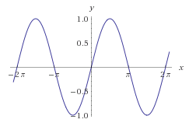
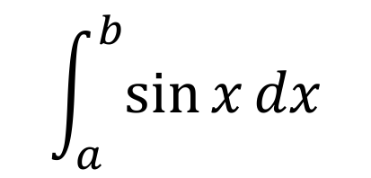
One SciPy Example
We can’t possibly tour all of the SciPy library and, even if we did, it might be a little boring.
Often, you’ll be able to find higher-level modules that will work around your need to directly call low-level SciPy functions
Say you want to compute an integral:
$$\int_{a}^{b}{\sin{x}dx}$$

Slide 64
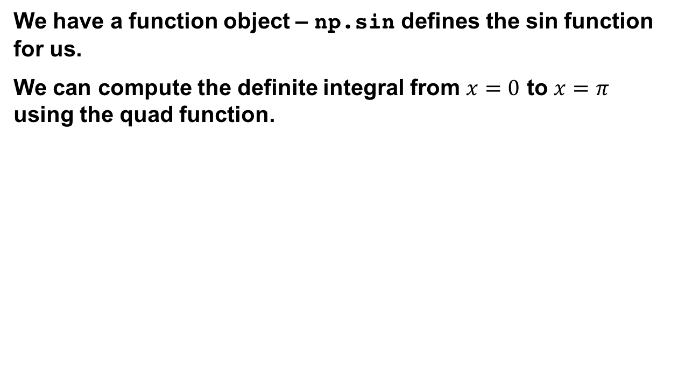
Scipy.integrate
We have a function object – np.sin defines the sin function for us.
We can compute the definite integral from $x=0$ to $x=π$ using the quad function.
>>> res = scipy.integrate.quad(np.sin, 0, np.pi) >>> print(res) (2.0, 2.220446049250313e-14) # 2 with a very small error margin! >>> res = scipy.integrate.quad(np.sin, -np.inf, +np.inf) >>> print(res) (0.0, 0.0) # Integral does not converge

Slide 65
Scipy.integrate
Let’s say that we don’t have a function object, we only have some (x,y) samples that “define” our function.
We can estimate the integral using the trapezoidal rule.
>>> sample_x = np.linspace(0, np.pi, 1000) >>> sample_y = np.sin(sample_x) # Creating 1,000 samples >>> result = scipy.integrate.trapz(sample_y, sample_x) >>> print(result) 1.99999835177
>>> sample_x = np.linspace(0, np.pi, 1000000) >>> sample_y = np.sin(sample_x) # Creating 1,000,000 samples >>> result = scipy.integrate.trapz(sample_y, sample_x) >>> print(result) 2.0

Slide 66
Wrap up: First Part
Shift thinking from imperative coding to operations on datasets
Numpy: A low-level abstraction that gives us really fast multi-dimensional arrays
Next class:
Pandas: Higher-level tabular abstraction and operations to manipulate and combine tables
Reading Homework focuses on Pandas and SQL

